Slide 1
Service—news
Input | Output
Tap sequence | Audio
Voice command | Text and picture
Screen input | Video

Slide 2
Overall Design
Device synchro
News-related functions
Sharing
Liking
Later-viewing
News searching
Related news
Multiple input method
Intelligent output
Voice self-adjustment
Auto-interruption

Slide 3
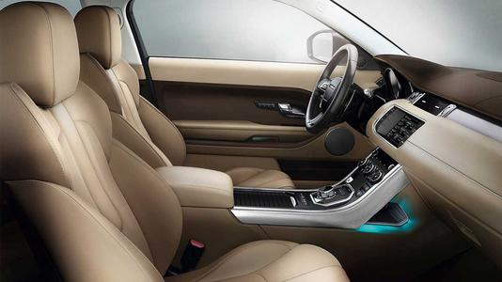
Scenario 1: In Car

Slide 4
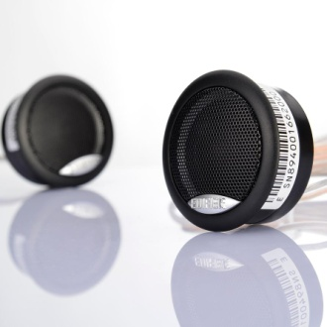
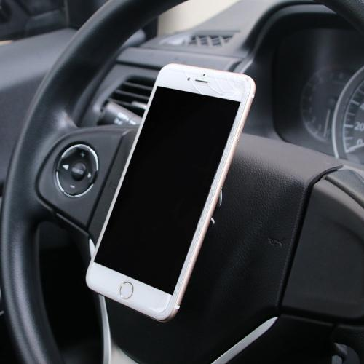
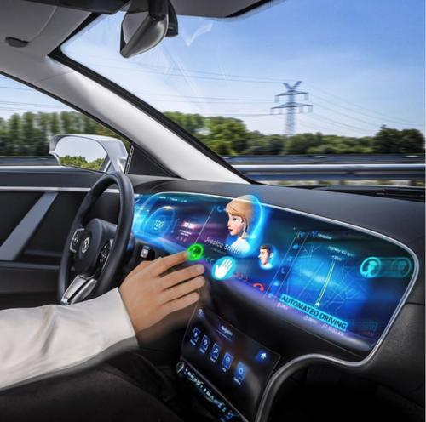
Devices
Car stereo
Smartphone/onboard touch screen
Functions
Basic functions
News-related functions
Volume self-adjustment
Auto-interruption
Input (specified later)
Output
Audio news through car stereo
Visual contents through smartphone/onboard touch screen

Slide 5

Scenario 2: Home

Slide 6
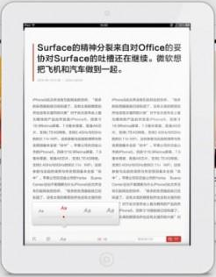
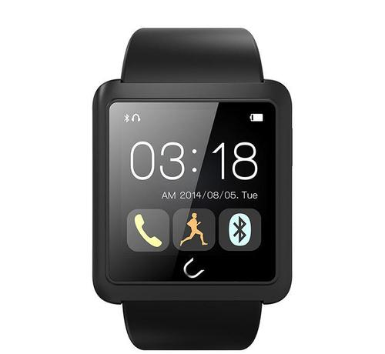
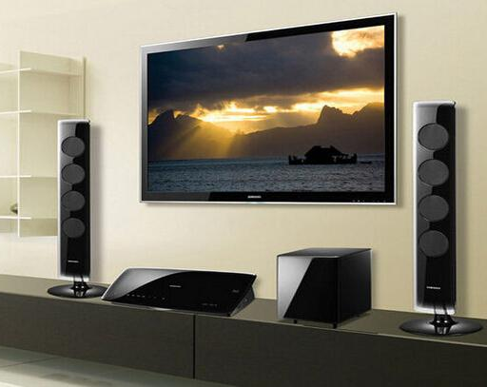
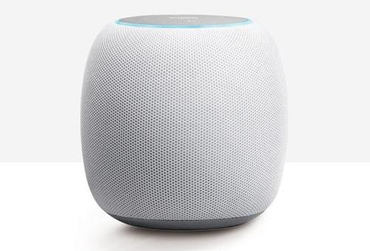
Devices
Smartphone/pad/PC
Smartwatch
Smart TV
Bluetooth Speaker/earphones
Functions
Basic functions
News-related functions
Transfer of control and content between devices
Auto-pause
Remote control
Transfer of voice output between stereos according to location
Input (specified later)
Output
News with texts and pictures through smartphone/pad/PC
Video news through smartphone/pad/PC and smart TV
Audio news mainly through Bluetooth Speaker/earphones

Slide 7

Scenario 3: Exercising

Slide 8
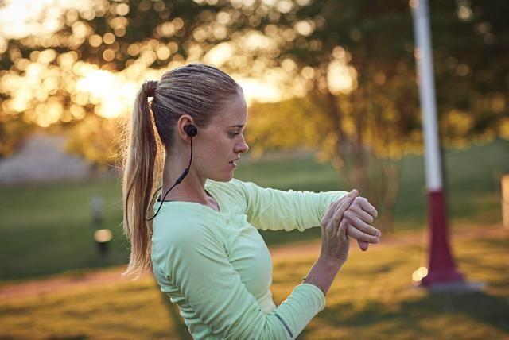
Devices
Smartphone
Smartwatch
Earphones
Functions
Basic functions
News-related functions
Volume self-adjustment
Input (specified later)
Output
Audio news through earphones

Slide 9
Input – Basic functions
Functions | Interaction | Scenario 1 In Car | Scenario 2 Home | Scenario 3 Exercising
Wake up | ① Knock twice with the smartwatch | ①② | ①② | ①
 | ② Say “Hi, New”
Play/Pause | ① Say “Play”/”Pause” | ① | ①② | ③
 | ② Press the button on smartwatch screen (specified later)
 | ③ Knock "xx“ on smartwatch
Turn to next news | ① Say “Next” | ① | ①② | ③
 | ② Press the button on smartwatch screen (specified later)
 | ③ Knock “x xx“ on smartwatch

Slide 10
Input – Basic functions
Functions | Interaction | Scenario 1 In Car | Scenario 2 Home | Scenario 3 Exercising
Volume adjustment | ① Say “Up”/“Down”: increase or decrease of the volume is positively proportional with the length of the voice command. | ①②③ | ①③④ | ③④
 | ② Slide up/down with the thumb on the steering wheel, with a sensor or gesture detection camera
 | ③ Drag on smartwatch screen (specified later)
 | ④ Punch up/down with the smartwatch
Choose news genres | ① Choose on the smartphone | ①②③ | ①②③ | ②
 | ② Choose on smartwatch screen
 | ③ Say “Change”

Slide 11
Input – News-related functions
Functions | Interaction | Scenario 1 In Car | Scenario 2 Home | Scenario 3 Exercising
Later viewing | ① Say “Save” | ① | ①② | ②
 | ② Press on the smartphone for 2 seconds
Sharing | ① Share on the smartphone through later-viewing | ①② | ①② | ①
 | ② -User: “Share” -System: “Who do you want to share with?” -User: “XXX“ (with a list of people user often shares news to)
News searching | -User: "Search“ -System: "What do you want to search?“ -User: "KEYWORD" | ● | ●
Related news | Say "Related news" to enter this mode Say "Stop" to exit this mode | ● | ●

Slide 12
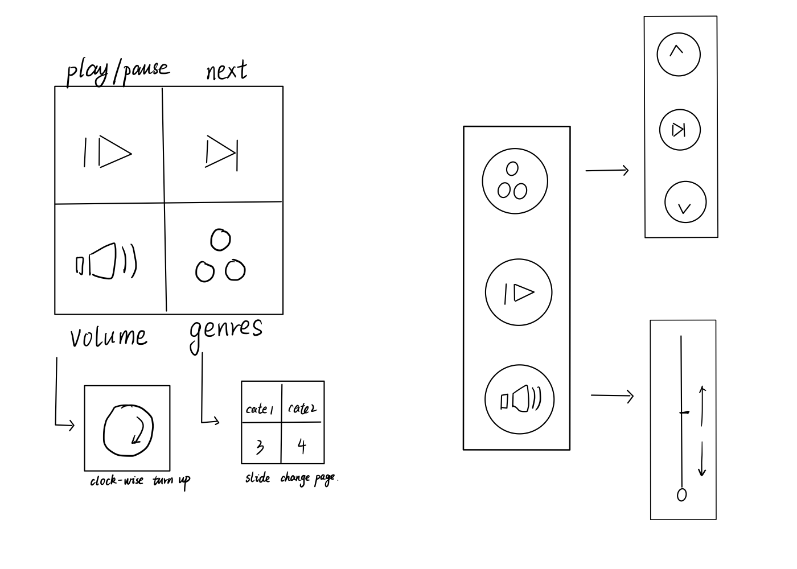
Smartwatch GUI

